Slide 1
What is important about it?
Dimensions of description

Slide 2
What is the information here?
Say we have part of a data set:
120 68 60 40 37 38 27 49
What do these numbers signify?
Without additional information about the information, we have no idea.

Slide 3
What is the information here?
Say we have some text:
I have something to say to you -- a word in your ear! I greet you -- please pay attention! In my city people are dying, and hearts are full of distress. People are lost -- that fills me with dismay. I craned my neck over the city wall: corpses in the water make the river almost overflow. That is what I see. That will happen to me too -- that is the way things go. No one is tall enough to reach heaven; no one can reach wide enough to stretch over the mountains. Since a man cannot pass beyond the final end of life, I want to set off into the mountains, to establish my renown there. Where renown can be established there, I will establish my renown; and where no renown can be established there, I shall establish the renown of the gods.
Without additional information about the information, the significance of this text is unclear.

Slide 4
Metadata
At the most basic level, metadata is just another term for description, or information about an entity.
For example, I open my dresser drawer and take out a sock: the sock color of the sock is white, material is cotton, and the length goes to my ankle.

Slide 5
Structured metadata
Attributes—also known as characteristics, properties, or elements—are the categories we use to describe a specific kind of entity more precisely. Color, material, and length are attributes of socks.
Values are a way to describe the possible contents of an attribute. White, cotton, and ankle are values of the Color, Material, and Length attributes.

Slide 6
Unstructured metadata
We can also just apply values (tags) to entities without specifiying attributes. The metadata for a sock might then be:
white
cotton
ankle

Slide 7
Problems with unstructured metadata
What if my socks are tagged:
Hot
Normal
Are my socks reeeaaally stylish and yet also utterly typical?

Slide 8
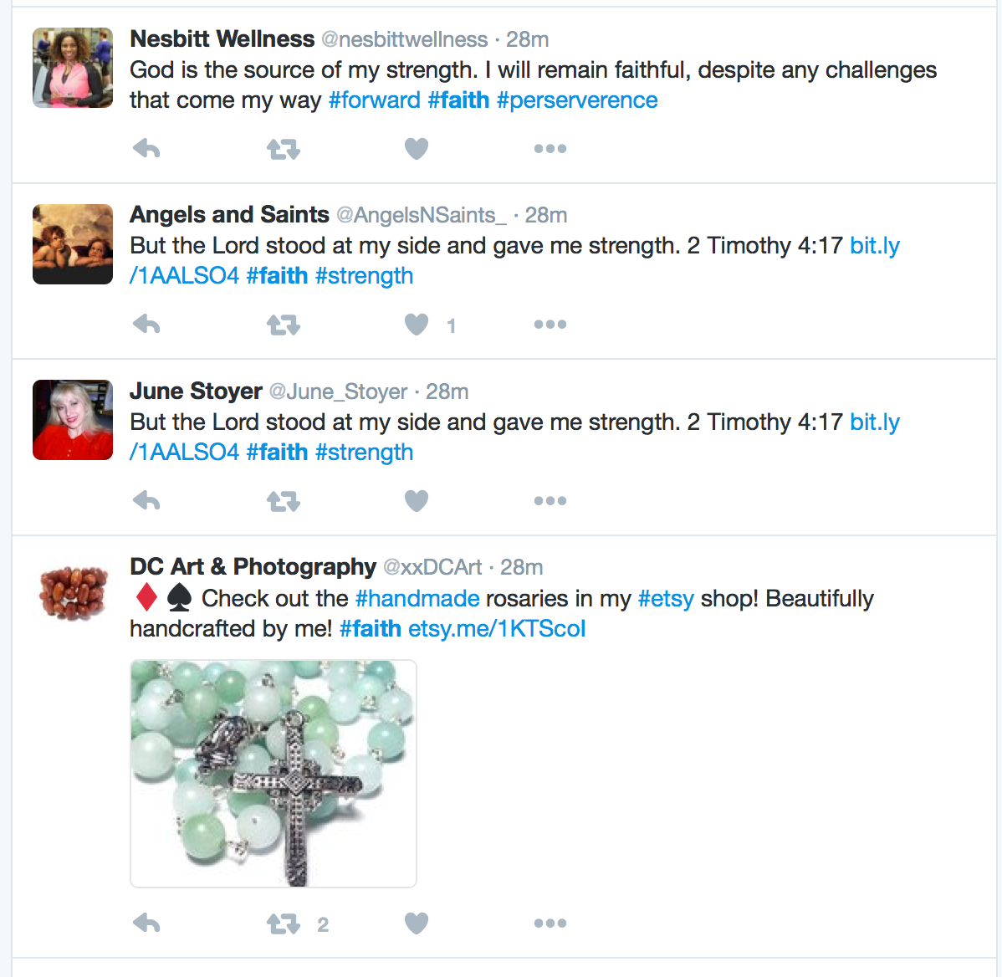

Slide 9
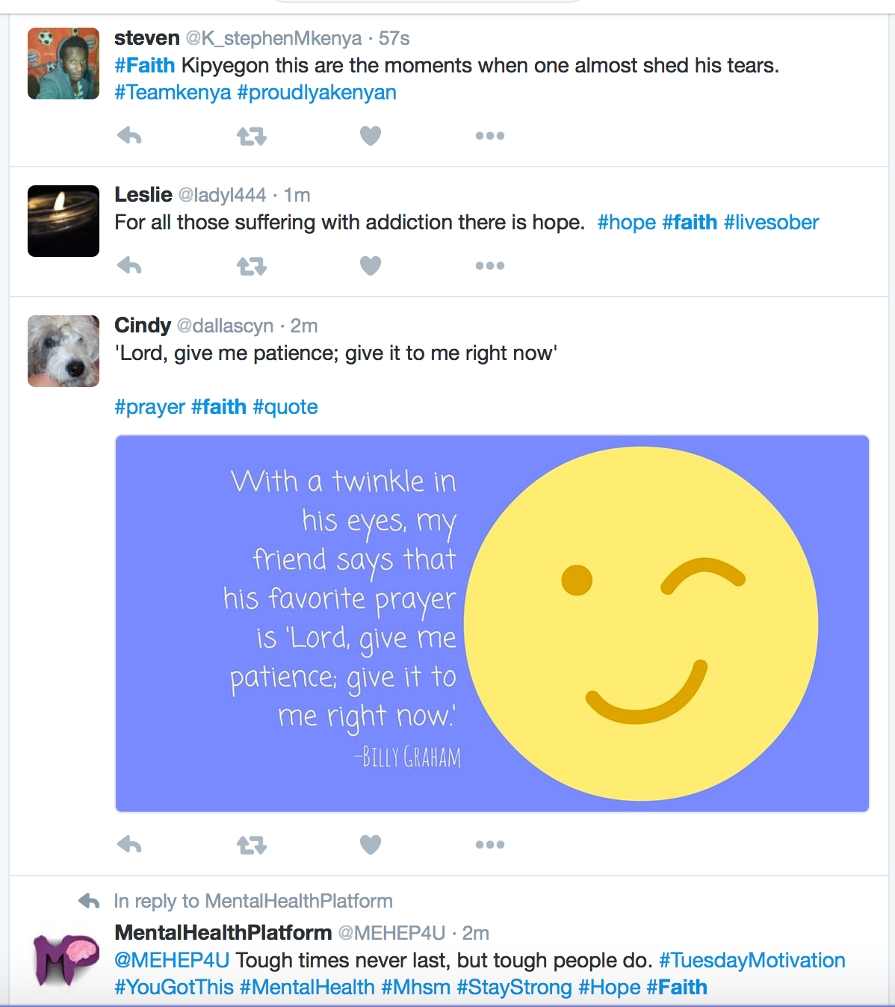
Notes:
Here we can see how #faith can indicate perseverance or belief in oneself, and that hard work will produce desired results: Myka A. Curry King of Hip Rock all use #faith like this.
# faith also indicates a general hope for a good outcome, as Chris Mercado uses it, or ccoMUN, hoping for a good outcome at a baseball game.
#faith is also used, of course, to refer to belief in the Christian religion as Terry Squires uses it...but Squires also incorporates a sense of usage #1, perseverance or belief in oneself, as well as Jesus.

Slide 10
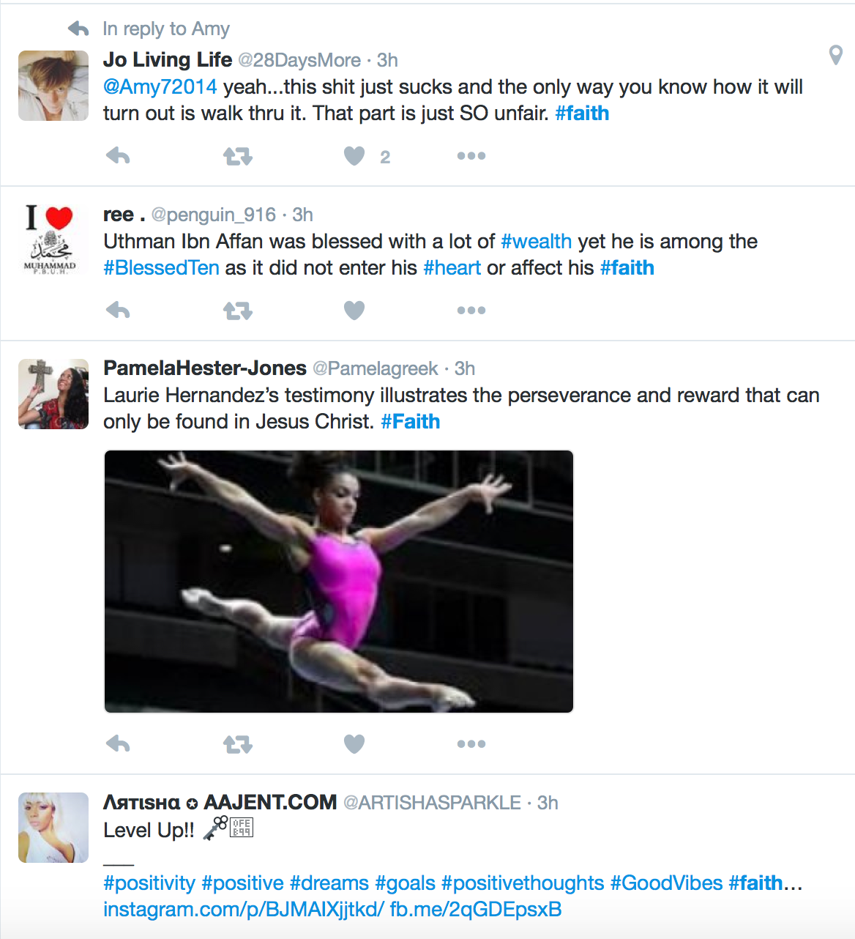

Slide 11
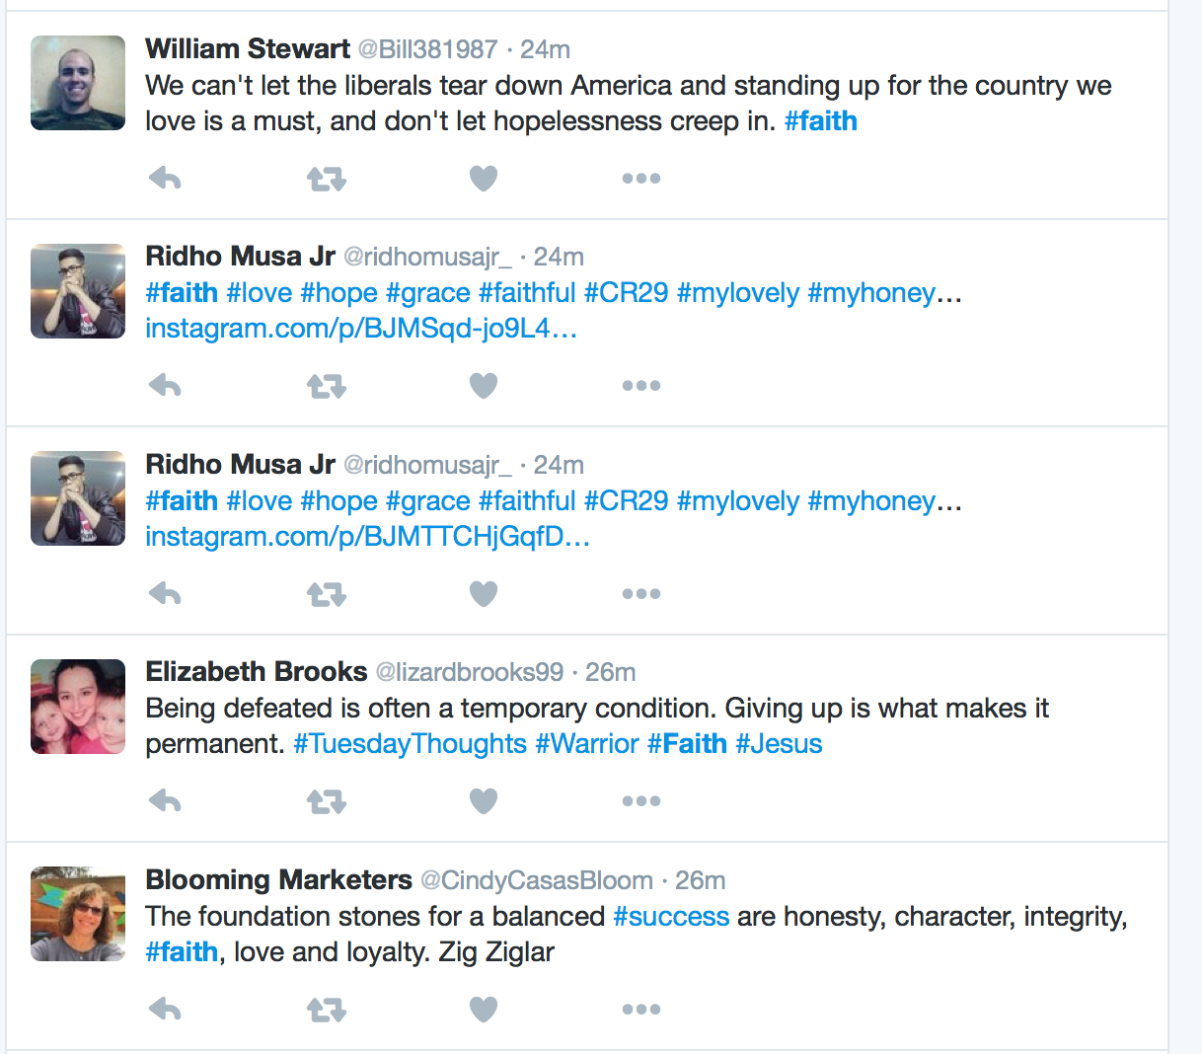

Slide 12
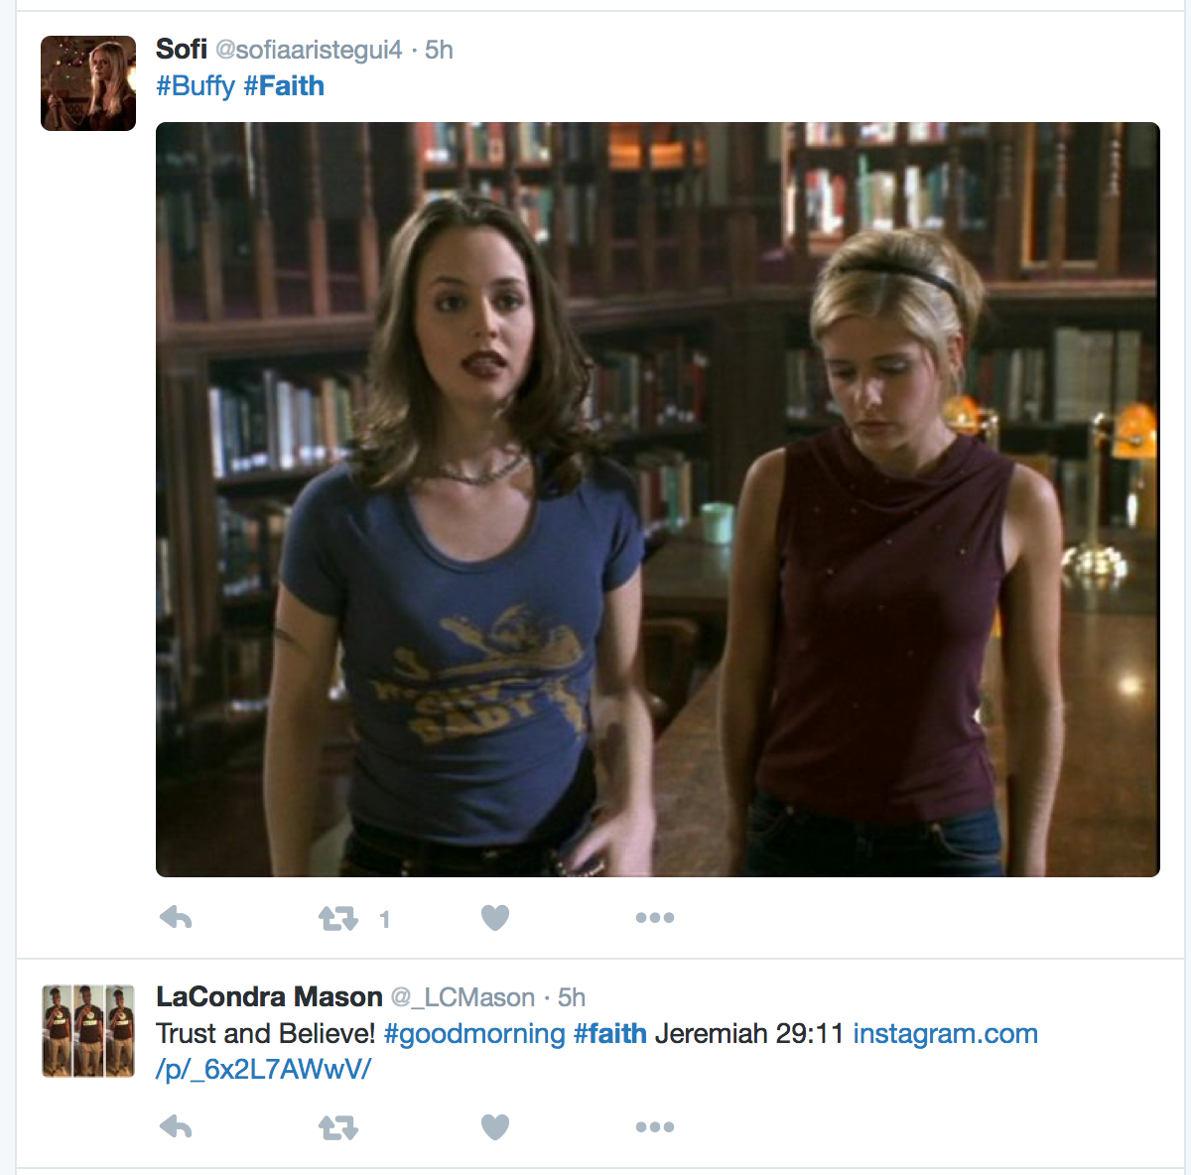
Notes:
Faith is also used to specify a fictional character from a TV series.

Slide 13
Balancing flexibility and stability
Structured metadata reduces semantic diversity and helps to enable more precise discovery, facilitate access, and increase the reliability of data in use.
Schemas, or defined sets of attributes, are a primary means of structuring metadata.

Slide 14
Schemas, or attribute sets
A schema is a set of attributes and associated value parameters designed to describe a particular type of entity.
Schemas may be encoded in a particular syntax for manipulation by people or computers.
Schemas may also be associated with rules for creating records (that is, assigning attributes and values to specific resources).

Slide 15
Example: ACLED actor attributes
ACLED is a schema for describing events of armed conflict.
The ACLED schema includes several elements to describe “actors” in these events:
Actor name.
Actor type (from a list of controlled values).

Slide 16
Summary
One way of thinking about metadata is as a system of attributes and associated values to describe entities.
Values are often restricted according to certain parameters for both syntax and semantics.
Unstructured metadata (tags) involves unrestricted (or less restricted) values associated with entities.
Sets of attributes and allowable elements are called schemas.

